Slide 1

December 8 | Four Seasons Hotel | Washington D.C.

Slide 2
Student Recruitment and
Stakeholder Engagement

Slide 3

Recruiting the next generation of PTs and PTAs

Slide 4



Ryan Bannister
Mya Shackleford
Director, CAS and Student Recruitment
Manager, Student Recruitment

Slide 5
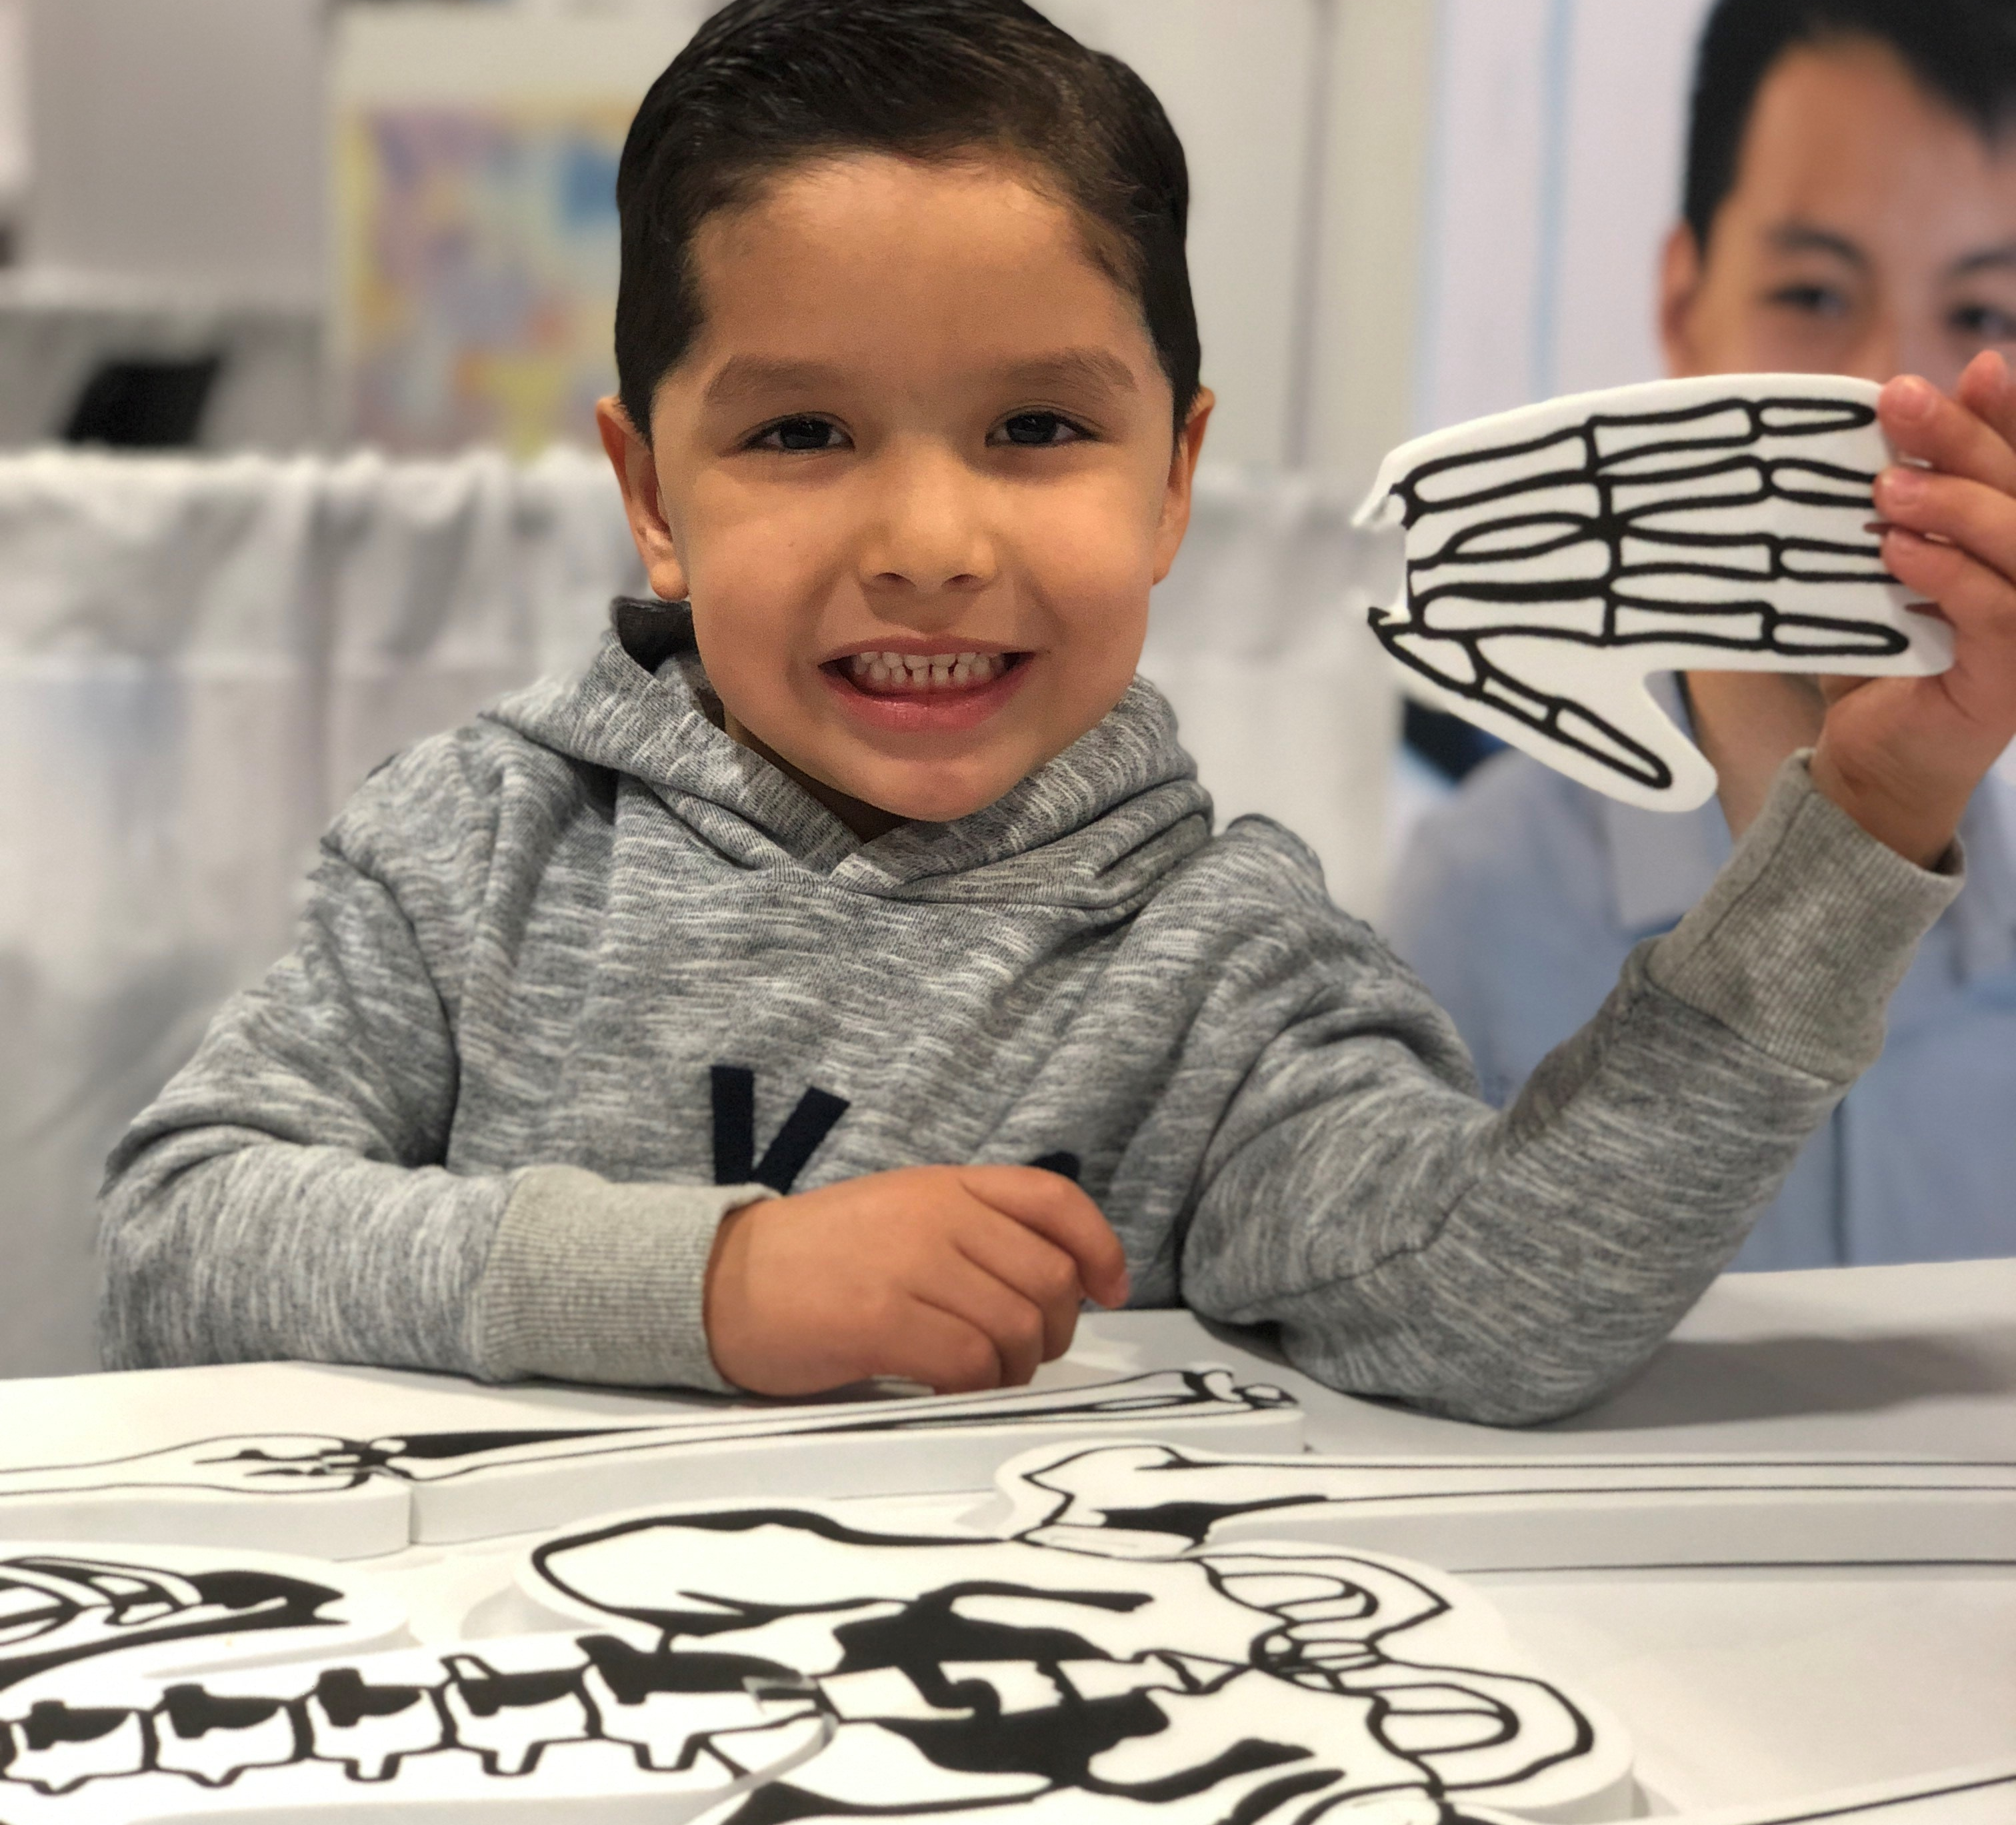
PT Moves Me Ambassador Program
GRASSROOTS program that creates IMPACT through ENGAGEMENT!
We aim to have continued PT Moves Me Ambassador representation in every DPT and PTA education program, chapter, and clinic across this country.
With PT Moves Me Ambassadors on the local, regional, state, and national level working to achieve the desired goals through grassroots community engagement, physical therapy can will be known in every community and home.

Slide 6
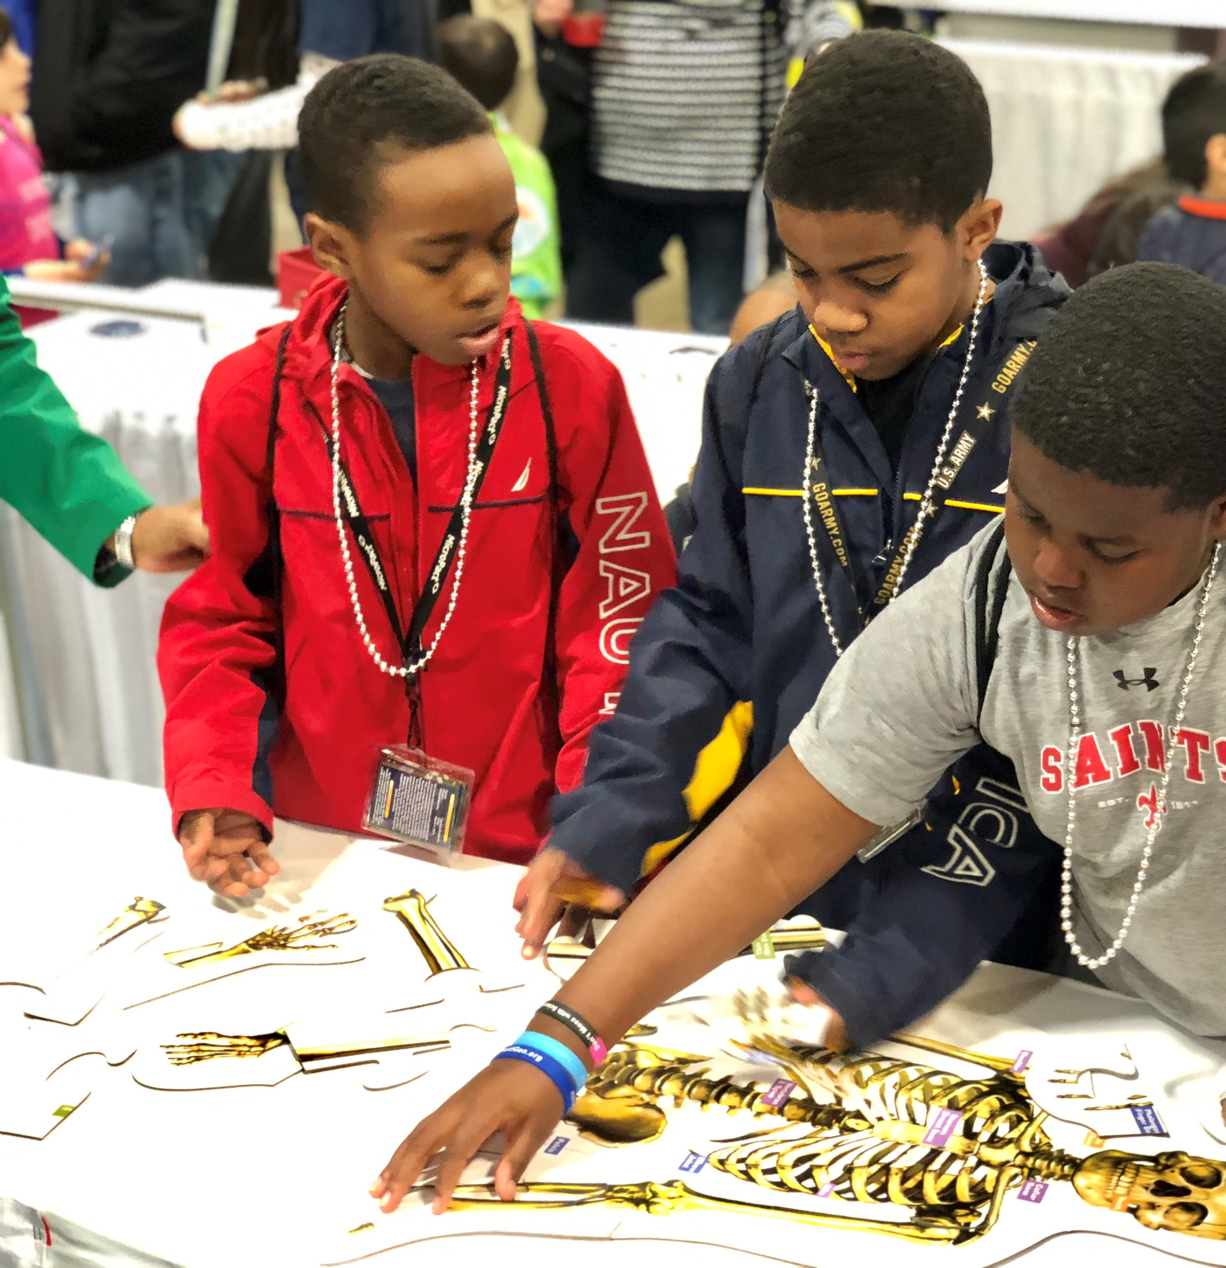
PT Moves Me Goals
Increase awareness of the profession of physical therapy
Recruit the next generation of physical therapist and physical therapist assistants
Increase the diversity of the application pool, and ultimately, the profession

Slide 7
PT Moves Me Ambassador Program Phased Rollout
Education Ambassadors
January 2021
01
Chapter Ambassadors
July 14, 2021
02
Corporate/Clinic Ambassadors
Launching in 2023
03

Slide 8
PT Moves Me Ambassador Focus
Education Programs
Four ambassadors
Chapters
Three ambassadors
Statewide engagement
Clinics
TBD
Profession recruitment
and
Community engagement
APTA
Hub community, resources, and ambassador support
National engagement
and
Partnership development
Profession recruitment
and
Community engagement
Local engagement
Program recruitment
and
Community Engagement
Regional engagement
Profession recruitment
and
Community engagement

Slide 9
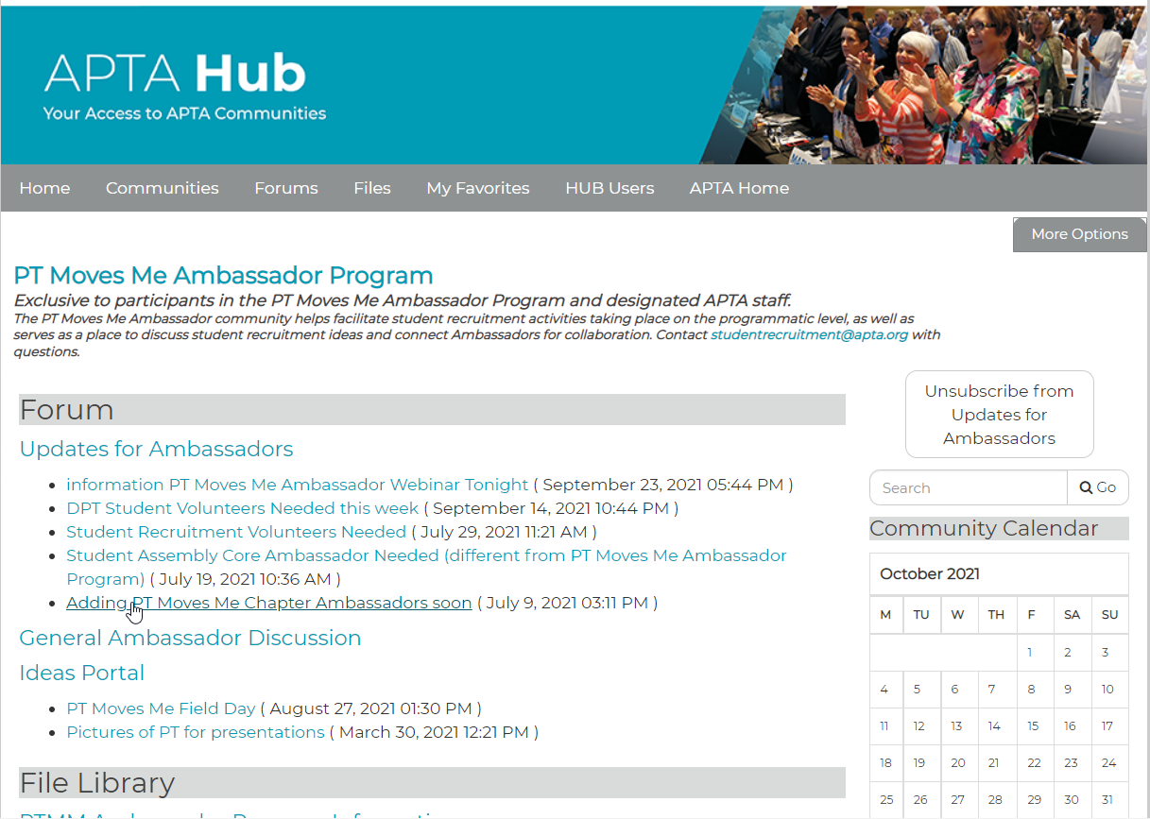
PT Moves Me Ambassador Hub Community
Hub:
Ideas Portal
Discussion
Quarterly Meetings
Materials:
Power Points (K-12, college)
Talking Points
Flyers and Handouts
Guides
Photos
Videos
Website Links
Articles
Activity Sheets
Reports

Slide 10
PT Moves Me Ambassador Representation
WA
ME
MT
ND
VT
OR
MN
NY
NH
ID
SD
WI
MA
MI
CT
RI
WY
PA
NJ
IA
NV
NE
OH
DE
IL
IN
MD
UT
WV
VA
CA
CO
KS
MO
KY
DC
NC
TN
AZ
OK
AR
SC
NM
GA
MS
AL
TX
LA
No Representation
AK
FL
Education Ambassadors only
Education and Chapter Representation
HI
Chapter Ambassadors only
Notes:
So far this is the impact that we have nationally and we want to continue to grow.
This map gives a visual of Ambassador representation by state.
Green represents states with Education Ambassadors and Chapter Ambassadors
Blue represents states with only Education Ambassadors
Purple represents states with only Chapter Ambassadors
And Grey represents states without any PT Moves Me Ambassador representation.
Goal is to have 100% of PT education programs (DPT and PTA) and 100% of chapters represented.

Slide 11
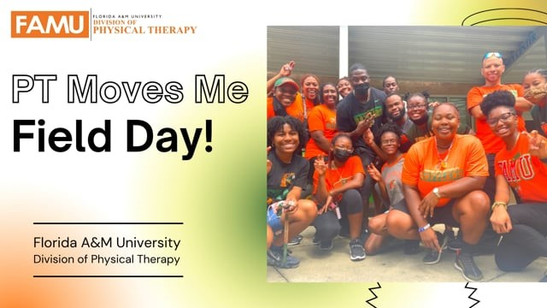

Slide 12
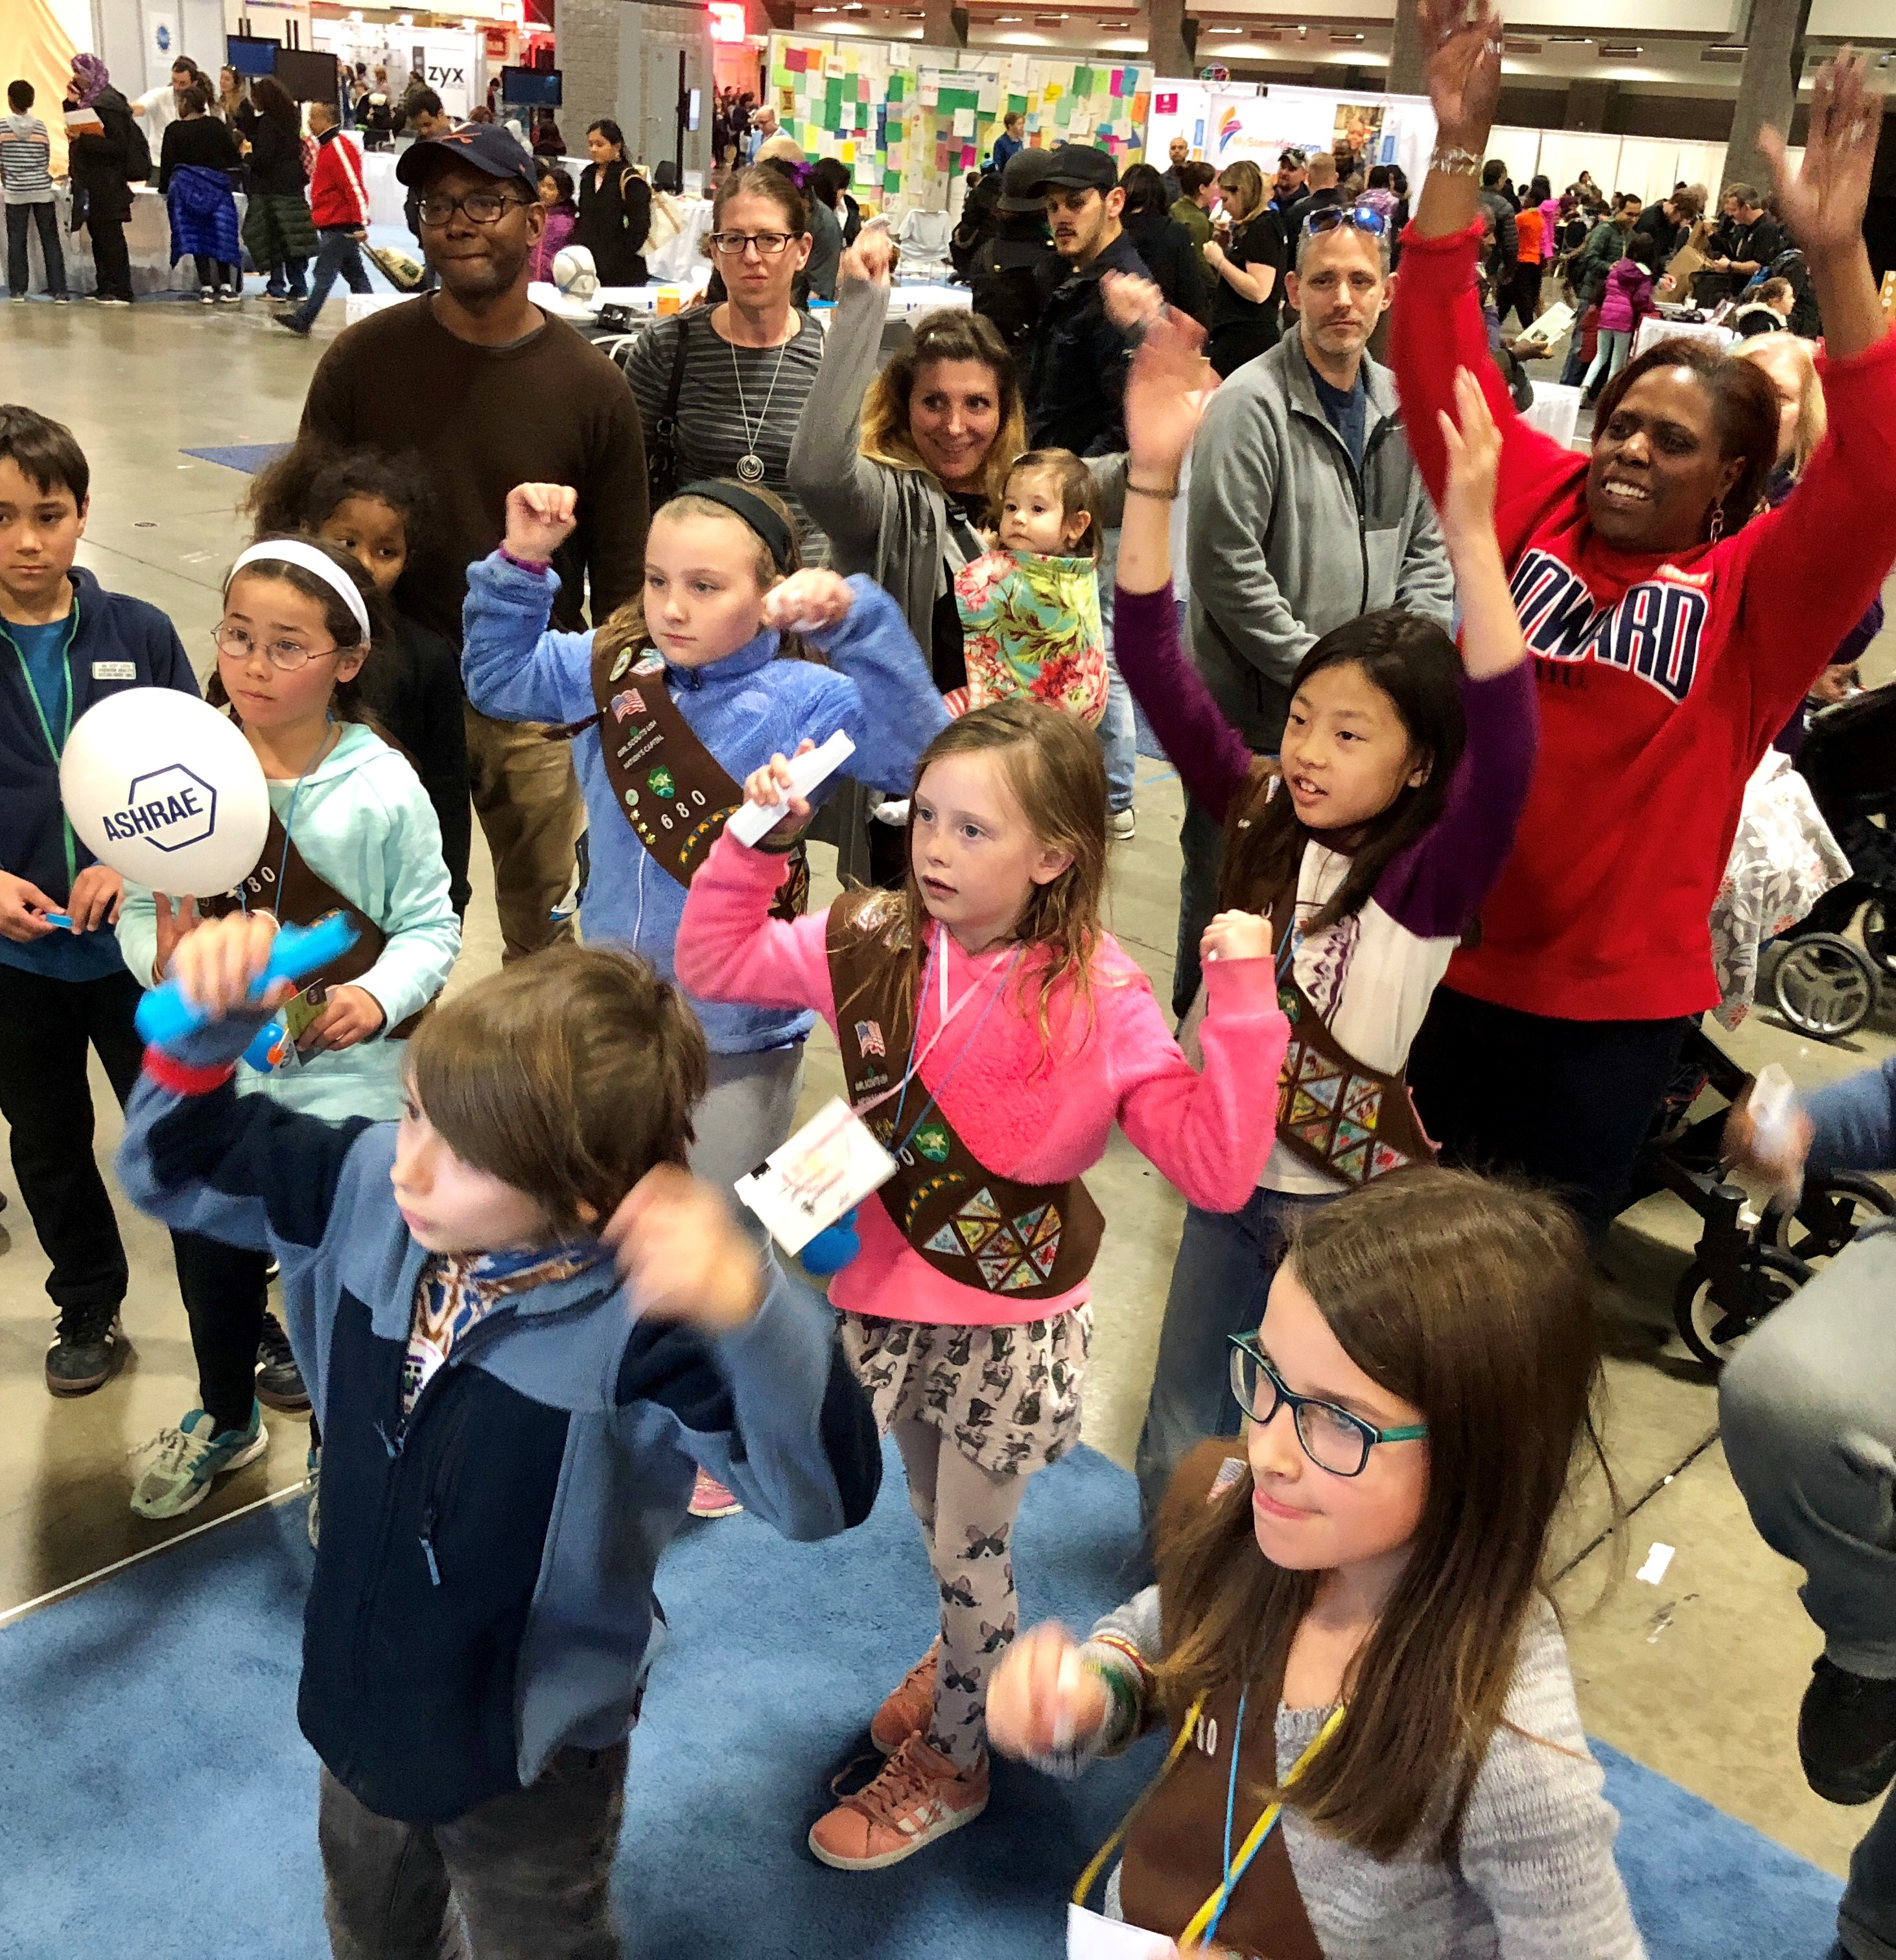
PT Moves Me Ambassador Impact
Field day
Social media engagement
Summer programs
Mentorship
Information sessions
Admissions workshops
Interprofessional opportunities
Inclusive language review
Holistic admissions implementation
And more…

Slide 13


Leveraging Stakeholder and Partner Relationships

Slide 14
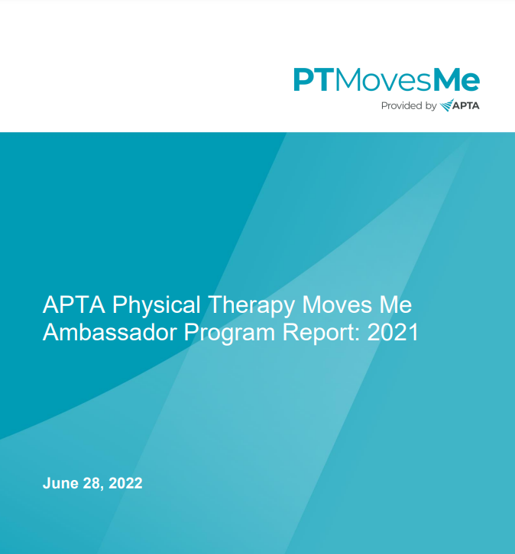
PT Moves Me Annual Report

Slide 15
Data Driven Student Recruitment
PT Moves Me
Annual Report
PTCAS
and
PTACAS
Data
CAPTE
and
Program Data

Slide 16
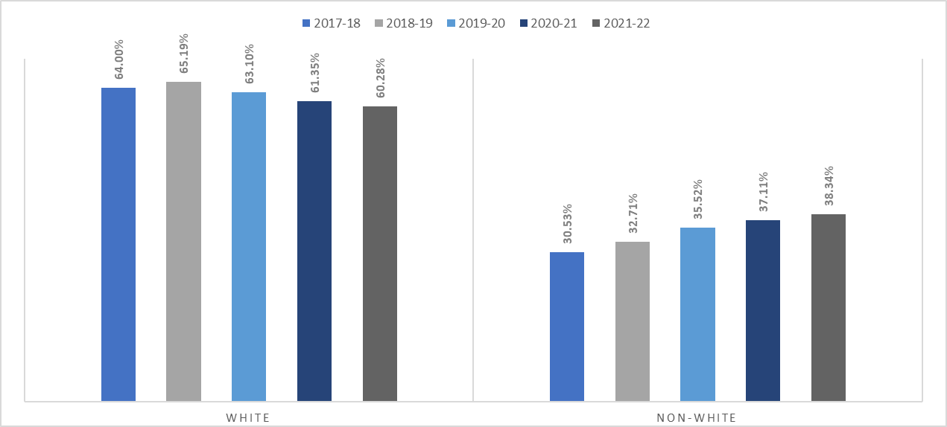
PTCAS Applicants

Slide 17
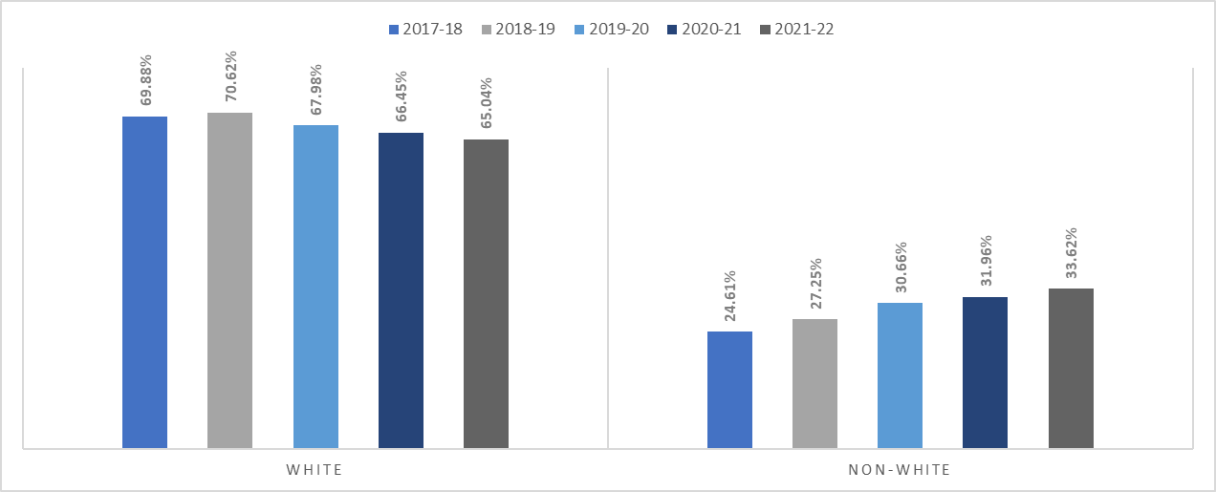
PTCAS Accepted Students

Slide 18
Life Cycle of Data Driven Recruitment
Vision & Mission
Intentional Recruitment
Partnerships
Data Collection
Transparent Data Reporting
Holistic Admissions

Slide 19
Q&A

Slide 20
Thank You

