Slide 1



Slide 2


Navigating the Impact of Generative AI on the Admission Process
Date: July 25, 2023

Slide 3

Agenda
About Us
How Can Generative AI Be Used by Applicants
ChatGPT Demo
Generative AI and the Impact on Personal Statements
Ensuring Integrity in the Admissions Process
Questions

Slide 4
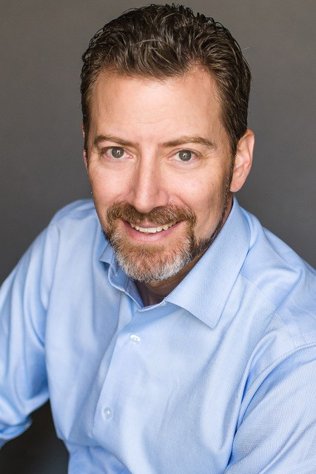
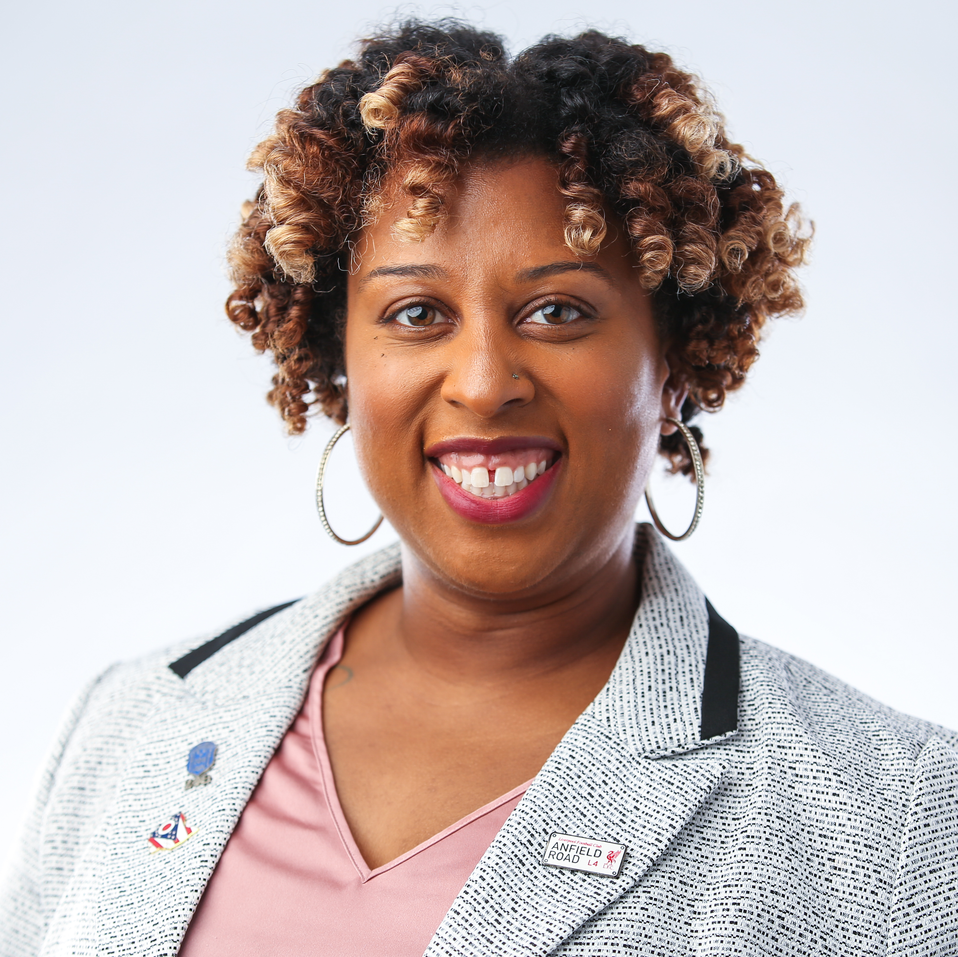
Meet Our Presenters
Marc Weinstein J.D.
Erika Brooks
Outside General Counsel
Application Services Manager
PA Education Association
PA Education Association

Slide 5

What is your understanding of how Generative AI technology works?

Slide 6

Have you used Generative technology before?

Slide 7

Is your Institution making adjustments to user agreements to prohibit the use of generative AI technology during the primary or secondary application?

Slide 8

How Can Generative AI Be Used by Applicants
Notes:
Could you give us a simple explanation of what generative AI is, and how it functions in a chatbot like ChatGPT?" (Erika ask Marc)
Generative AI seems to be a powerful tool. Could you explain how it might be used by applicants to a PA program to write their personal statements and make use of it throughout the application?" (Erika ask Marc)

Slide 9
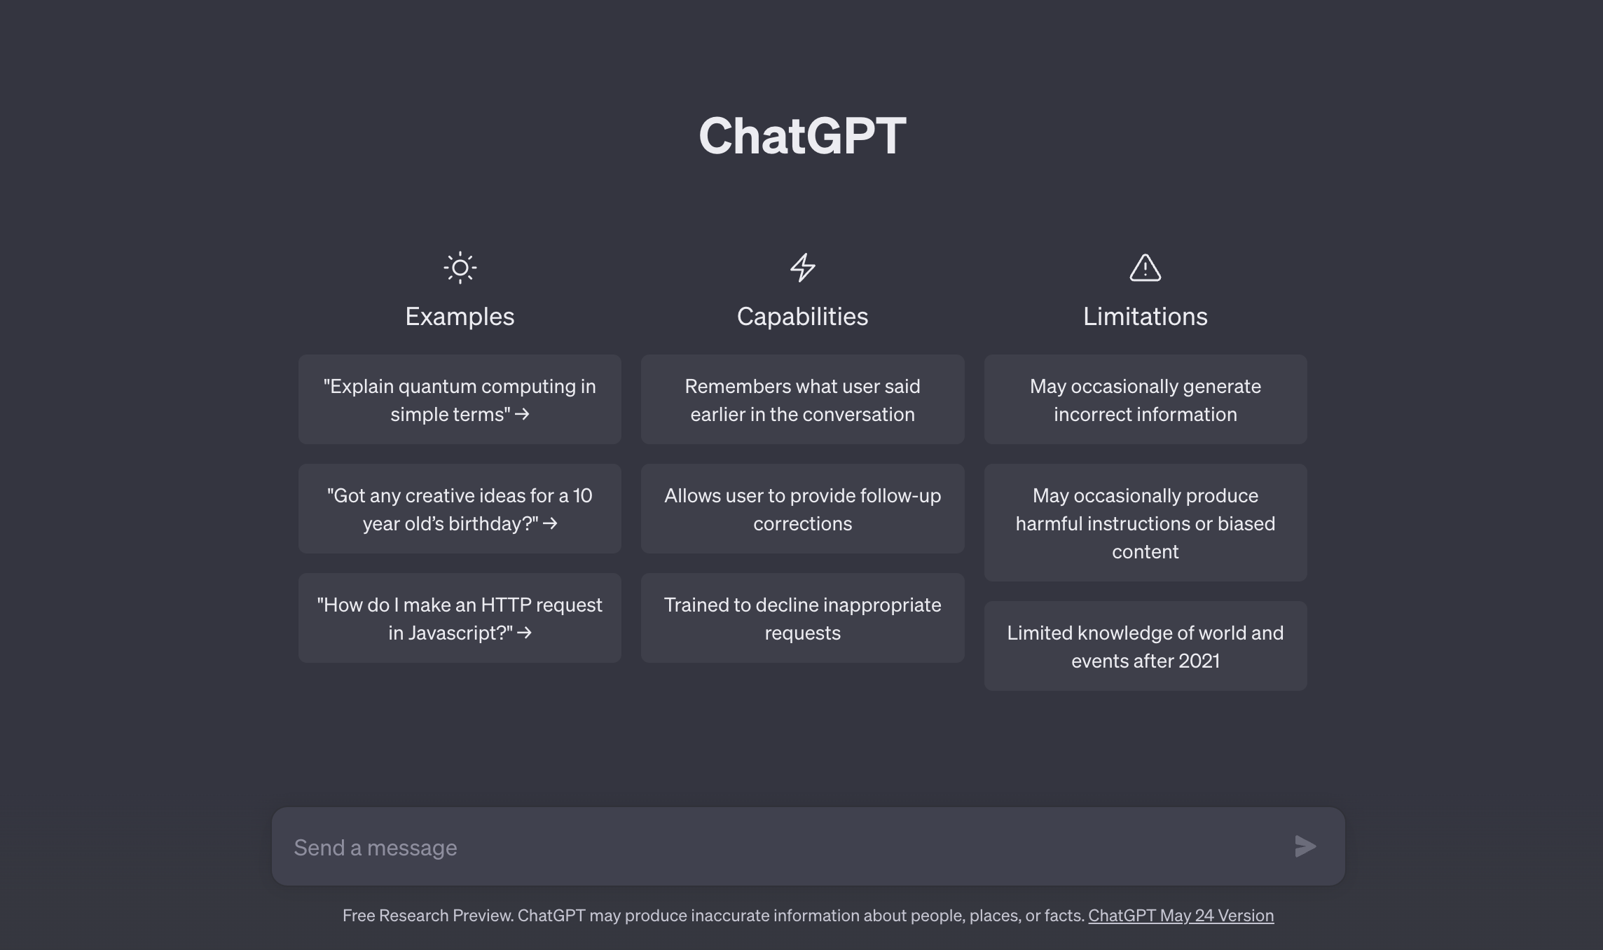
ChatGPT Demo

Slide 10

Generative AI and the Impact on Personal Statements
Notes:
Are there reliable tools that programs can use to detect when generative AI has been used to write a personal statement?”(Erika ask Marc)
Why do we care about personal statements in PA school admissions, how are they used, how do admissions committees rely on them? (Marc ask Erika) Marc to add in info about SCOTUS decision.
The question of authenticity in personal statements is not a new issue in admissions for PA programs. Could you elaborate on how the advent of generative AI just presents a different facet of this ongoing challenge?" (Marc to Erika)

Slide 11

Ensuring Integrity in the Admissions Process
Notes:
What is PAEA doing about this?” (Marc to Erika)
What can programs do to ensure the authenticity of personal statements and have a reliable application process?” (Marc to Erika)

Slide 12
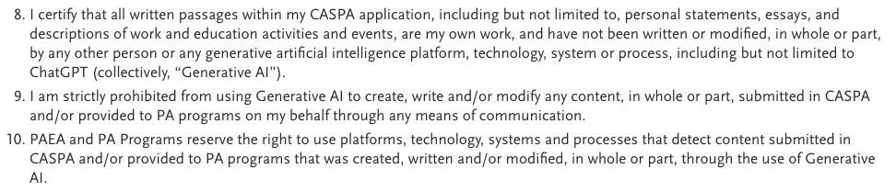
CASPA Applicant User Agreement and Release

Slide 13


Q&A

Slide 14
Thank You
Marc Weinstein
Outside General Counsel for PA Education Association
marc@mjweinsteinlaw.com
Erika Brooks
PA Education Association
Ebrooks@PAEAonline.org

